Slide 1

DIY Battery
The League of Amazing Programmers
EE Class – Level 1

Slide 2
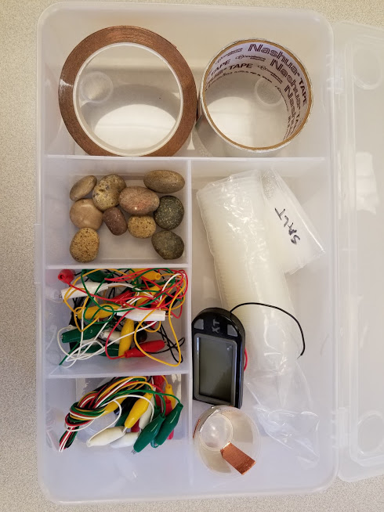
Materials
3 dosage cups
½ cup water
½ tsp salt
30 cm long copper tape strip, 6 pcs
30 cm long aluminum tape strip, 6 pcs
Small stones (for weight)
Jumper wires with small alligator clips, 4 pcs
Multimeter
Digital clock with wires

Slide 3
Instructions
This creates a simple battery using copper tape (often used for crafts), aluminum tape (often used for home heater ducting), and a salt water solution. It doesn’t put out much current (about 1 mA max) but is enough to drive an LCD clock.
Take a 30 cm length of each tape and tape on opposite sides of dosage cup
Fold extra tape over the lip of the cup
Wipe metal tape clean to remove oils and other contaminants
Add a small stone or other non-metal weight to help keep it stable
Attach alligator clips and wire together
Make a salt water solution with ½ cup water and ½ to 1 teaspoon of salt
Pour salt solution into cup. Fill ½ to ⅔ to the top.

Slide 4
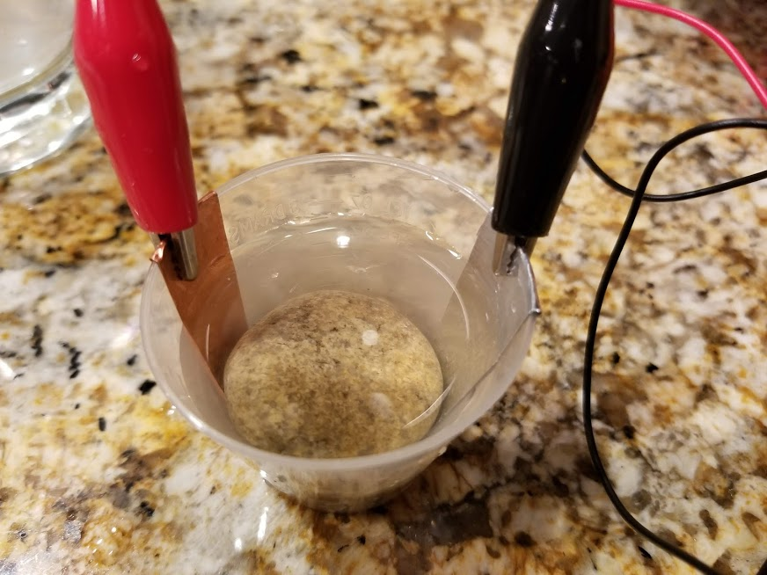
How to make one cell, about 0.5 Volts
Copper
tape
Aluminum
tape
+
-
Salt water
Non-metal weight

Slide 5
Wire three cells together, about 1.5 Volts!
+
12:00
-
+
-

Slide 6
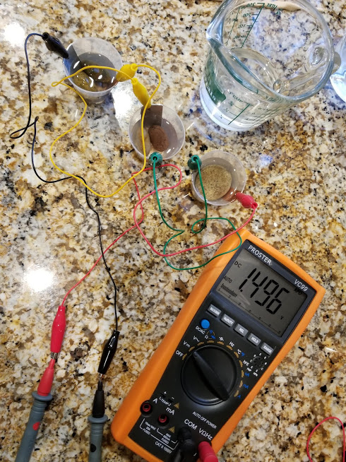
Example Setup

Slide 7
Appendix

Slide 8
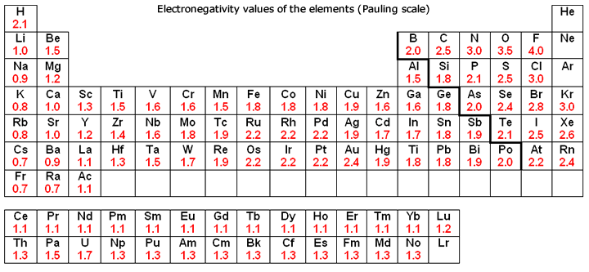
Electronegativity
Electronegativity is a chemical property which describes how well an atom can attract an electron to itself.

Slide 9
References
List of elecronegativity of the elments: https://sciencenotes.org/list-of-electronegativity-values-of-the-elements/
How batteries work
https://www.youtube.com/watch?v=PyrWx4ExZE4
https://www.youtube.com/watch?v=9OVtk6G2TnQ
https://www.google.com/search?q=diy+lemon+battery&rlz=1C1NHXL_enUS754US754&oq=diy+lemon+battery&aqs=chrome..69i57.2926j0j4&sourceid=chrome&ie=UTF-8#kpvalbx=1
https://en.wikipedia.org/wiki/Electric_battery

